Slide 1

Letter Data Mining The A Team
Evan, Serena, Logan, Zach

Slide 2
Problem Description
Image Classification
Dataset contains 16 unique features and 26 unique classes
Data fit using Random Forest Classification
Test new data against model and classified into what letter it most closely represents.
Notes:
logan
letter classification problem, using black and white images that represent pixelated letters. The process of image classification is taking data points derived from many different images of letters and breaking all the data into 16 different features. Some of the features that the dataset measures are the average number of horizontal edges in the image, and the average number of vertical edges, height of the image, and things of that sort. Once these features have been established, the data must be then cleaned and outliers removed, and the data trained. The data are then fit using a Random Forest Classifier. New data can be tested against the model and can be classified into what letter it most closely represents.

Slide 3
Formulate the task into a data mining problem
Classifying black and white images of letters using the most important features determined by Random Forest Classifier:
Xedge - The Mean edge count from left to right
Yedge - The Mean edge count from bottom to top
Y2bar - The mean y variance
X2bar - The mean x variance
Notes:
logan
We determined that our dataset would be best explained by using multi class classification to better understand the meaning of the data. The task involved classification of the letters based off of the 16 attributes to obtain the best possible accuracy for each letter classification. Separating the letters is the data mining task, and visualizing the data to better explain the results of our findings. We discovered information about each feature using the confusion matrix and feature importance plots. Determining the best algorithm is achieved by Cross Validation. Based on our dataset we determined that certain algorithms worked better than others for the Classification task because of their ability to use each feature independently. The classification is superior in the random forest model because the large number of features for each data point are best utilized to classify each data point.

Slide 4
Pre Processing Data
Standard Deviation method removes outliers >3 SD’s above or below mean
We used Boxplots to verify that Outliers are removed
Data does has noise automatically eliminated
Notes:
logan
The data consist of 26 capital letters from the English language that are based on 20 different fonts. Each letter within these fonts was randomly distorted to produce 20,000 unique stimuli. Each stimulus was then converted into 16 primitive attributes that are normalized between 0 and 15. There are no missing attribute values in this dataset as we removed the outliers of the dataset by removing values that were further than 3 standard deviations away from the mean.

Slide 5
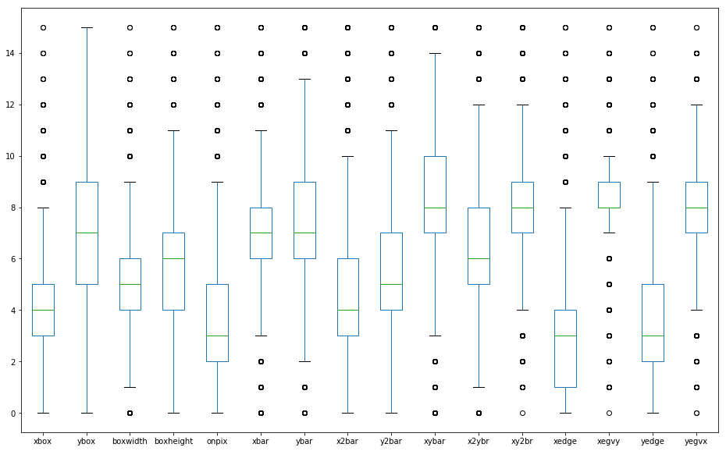
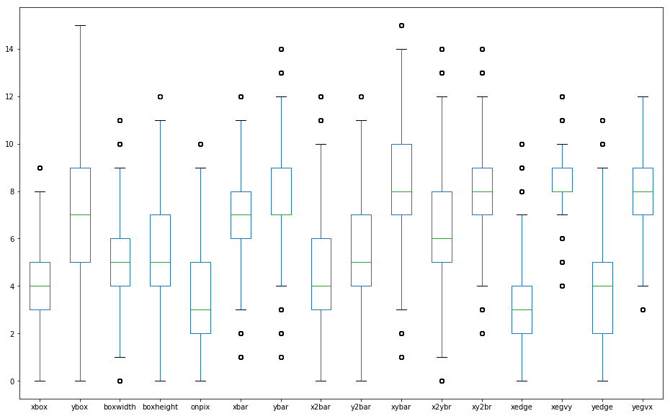
Boxplots shows the effect of our preprocessing
First plot is before we preprocess, second plot is after preprocessing
Remaining points are relevant data points
Outliers are removed
Notes:
logan

Slide 6
Algorithm Evaluation
Decision Tree model, Gradient Boosting Classifier, Random Forest, Logistic Regression, and K-Neighbors all evaluated
Analyzed all models using Grid-Search and Cross Validation
We classify using Grid Search to determine the best parameters and best scores
We evaluate the best model, Random Forest, using a Confusion Matrix

Slide 7
Best Model Based on Data
After running Grid-search and cross validation on each model, we found that a Random Forest Classifier was our best model, narrowly beating out the K-nearest neighbors classifier
Random forests perform better than binary trees since we have so many classes
Having many different trees allows us to calculate a better answer
Notes:
We chose the Decision Tree model, the Gradient Boosting Classifier, Random Forest, Logistic Regression, and K-Neighbors to build the model. After running Grid-search and cross validation on each model, we found that a Random Forest Classifier was our best model, narrowly beating out the K-nearest neighbors classifier. The best parameters for the random forest classifier were n_estimators = 30, criterion = ‘gini’ and max_depth = none. In other words, the number of trees that your model used was 30. The model used the gini index of the data to build the trees and the trees had no max depth.
Random forests perform better than binary trees as a general rule and since we have so many classes, having many different trees allows us to calculate a better answer. The random forest classifies the data as the mode of whatever the trees return. Since we have so many classes, the random forest is the most robust of the models we ran.

Slide 8
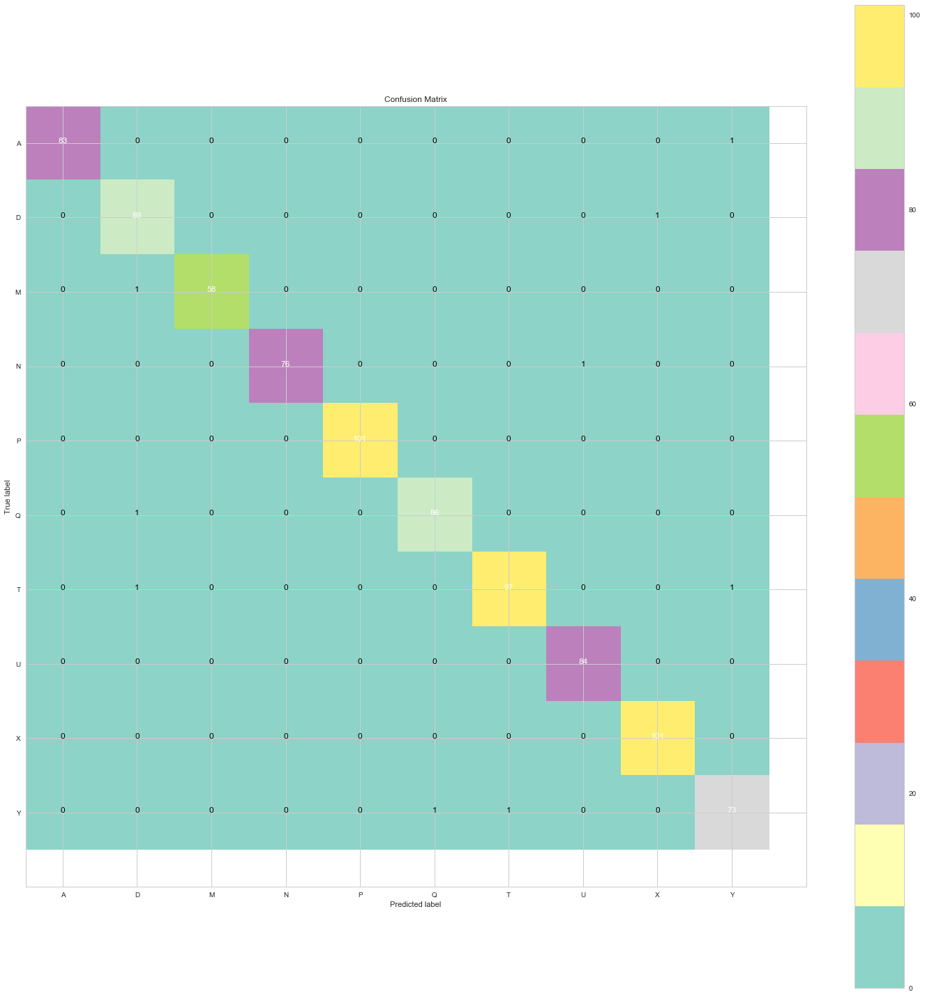
Visualization Methods
The Plotly, Seaborn, Bokeh, and MatPlotLib packages were used to make plots
Our Bokeh and Plotly plots are interactive
Confusion Matrix of Classification Error

Slide 9
Measures misclassification rate
We changed the color to improve contrast and readability
10 Most frequent letters (more than 780 instances) A D M N P Q T U X Y
Confusion Matrix of Classification Error

Slide 10
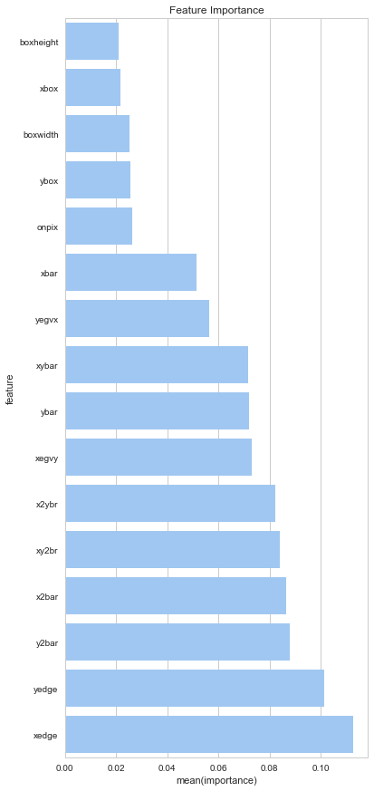
Feature Characteristics
The most important feature is xedge which tells the user the horizontal length in pixels
Very similar to the yedge that tells the user the vertical length in pixels
These are the most important features as they are the most defining characteristics of a letter

Slide 11
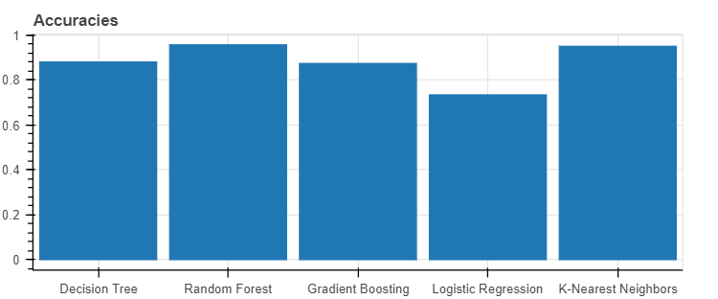
Bokeh Plot of Model Accuracies

Slide 12
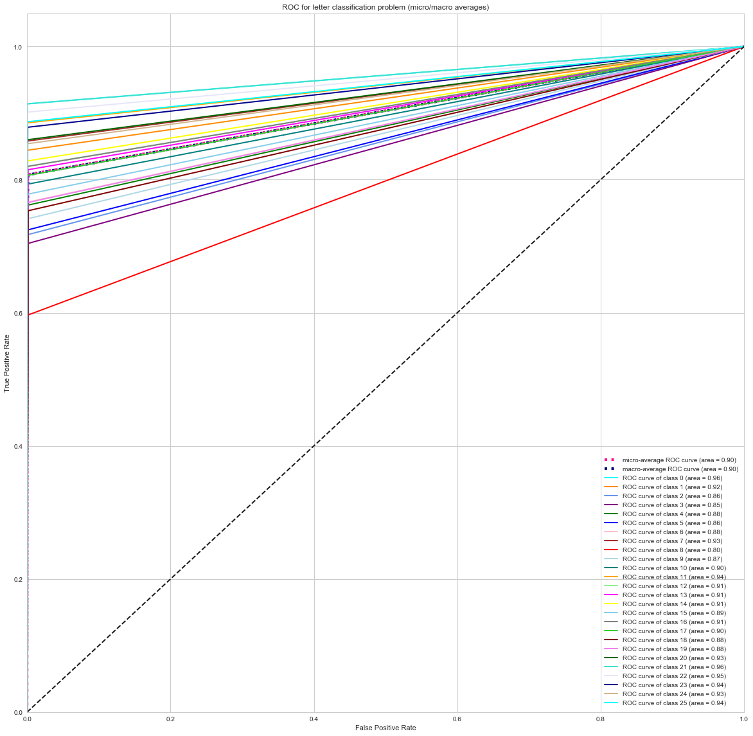
Receiver Operator Characteristic is based on our Random Forest Classifier
ROC plot of each feature shows the impact of each feature on our classification

Slide 13
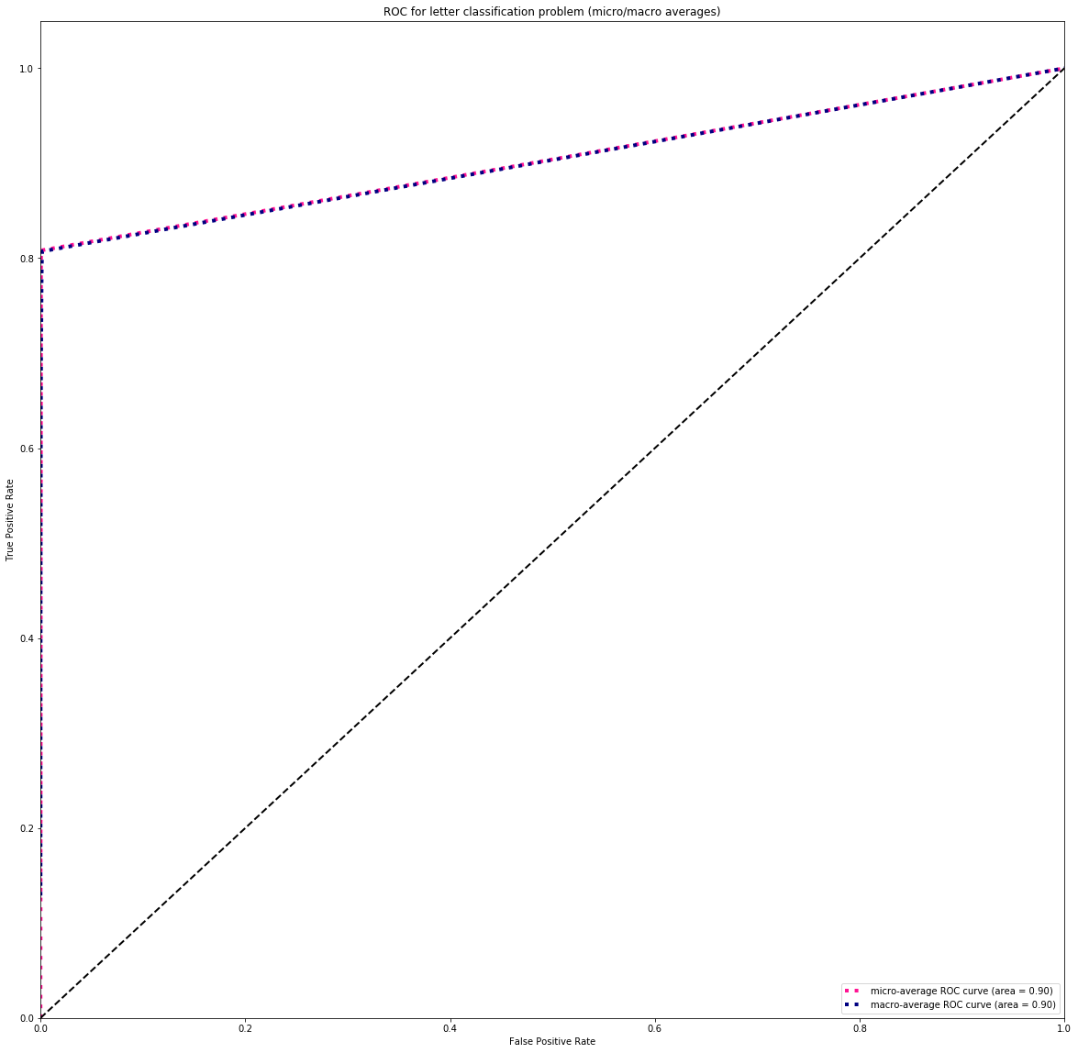
Receiver Operator Characteristic of Micro and Macro averages of all the features
Macro is overestimate of for the areas under the curve for each feature
Micro is underestimate of all the areas under the curve for each feature

Slide 14
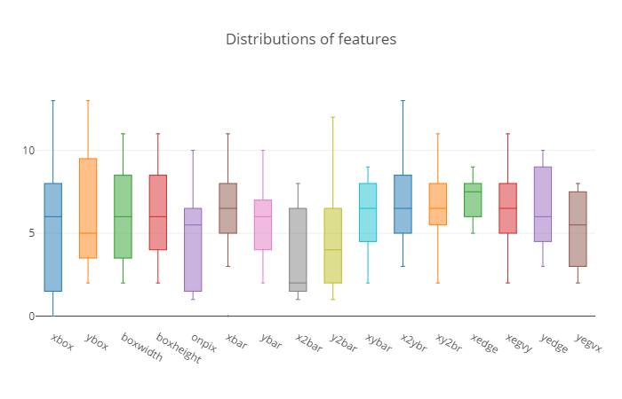
Feature Distribution

Slide 15
What We Improved Step-to-Step
Focused on improving overfitting problems
Model had too high accuracy, adjusted train/test data allocation to address this
Confusion Matrix Values reflected less overfitted data
Notes:
For the over fitting problem we continuously removed more and more of our dataset and trained our model on less and less data, and used more of the data for testing. We found that the lowest we could get our accuracy was 93% after training the model on half the data, and testing on the rest. Therefore we know that our data isn’t overfit.
We changed our confusion matrix from 26 letters down to the 10 most common letters which made it easier to read, and with these changes it showed that our data wasn’t over fit.

Slide 16
What We Learned
We became familiar with the patterns of letters and their features
We learned how to implement algorithms that are often used to describe data and extract meaning from large data sets
We learned how to best structure our data to be used for classification
We gained skills in utilizing various visualization libraries and discovered new methods of visualizing classification data

Slide 17
Conclusion
Number of training and testing points is critical to finding balance and accuracy to avoid overfitting, we learned to solve overfitting
Letters have many more features than we had considered which each contribute to one letter’s distinction from another
Learned to train a random forest classifier on data representing handwritten letters to deliver a high-accuracy, effective model
Learned to implement many visualization to best describe our classification data, models, and the effect of our algorithms

Slide 18
Future Applications of Our Data
Our data could be used to develop handwriting recognition software which is commonly used in the tech and automotive industries
Using our research, report, and presentation companies could assess the applicability of our data to their needs

